Slide 1
data_tructures(&algorithms, lecture03)
Doan Trung Tung, PhD – University of Greenwich (Vietnam)

Slide 2
Plan
Elementary Sorting Algorithms
01
Bubble Sort, Insertion Sort, Selection Sort
Quick sort
02
Recursive quick sort, non recursive quick sort
Merge Sort
Merging process, recursive merge sort
03
Heap sort
04

Slide 3
Elementary Sorting
Bubble sort, Insertion sort, Selection sort

Slide 4
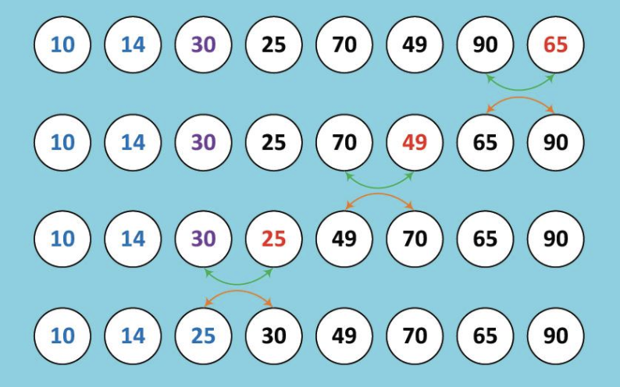
Bubble Sort
Key idea: going bottom-up, comparing 2 consecutive elements and let smaller element bubble-up
After the 1st run, the smallest element will bubble-up to the 1st position and so on.

Slide 5
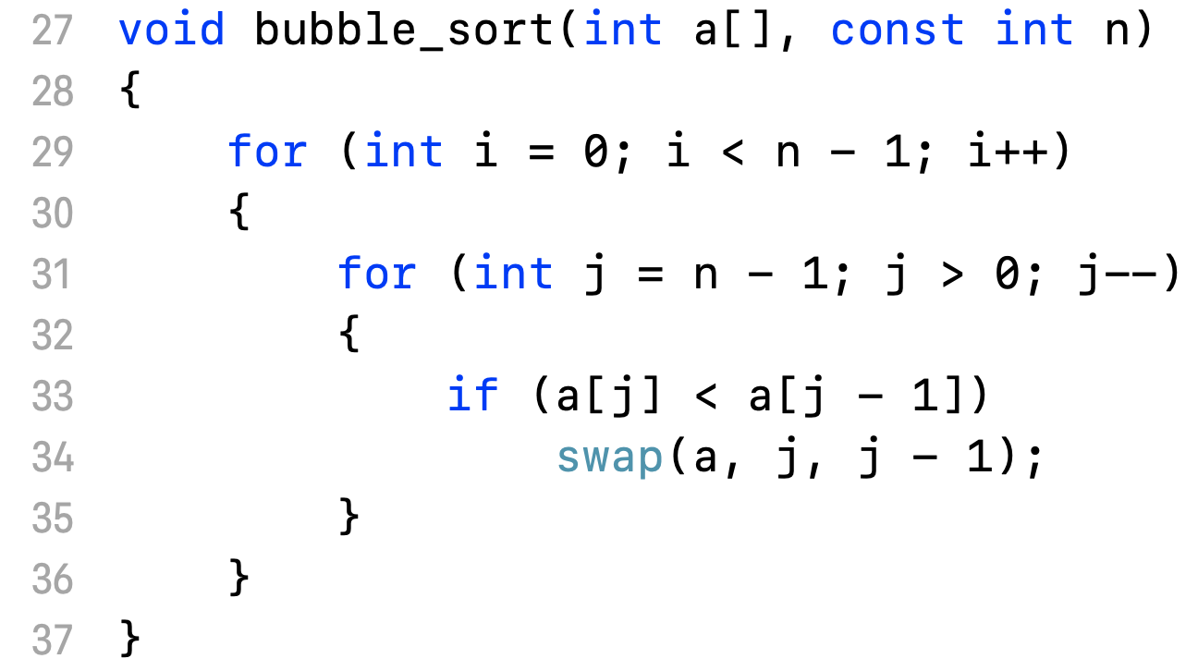
Bubble Sort
Bubble sort implementation

Slide 6
Bubble Sort
Analysis
Worst case
n(n-1)/2 comparisons
n(n-1)/2 exchanges
Best case
n(n-1)/2 comparisons
0 exchanges
=> In general, O(n²)

Slide 7
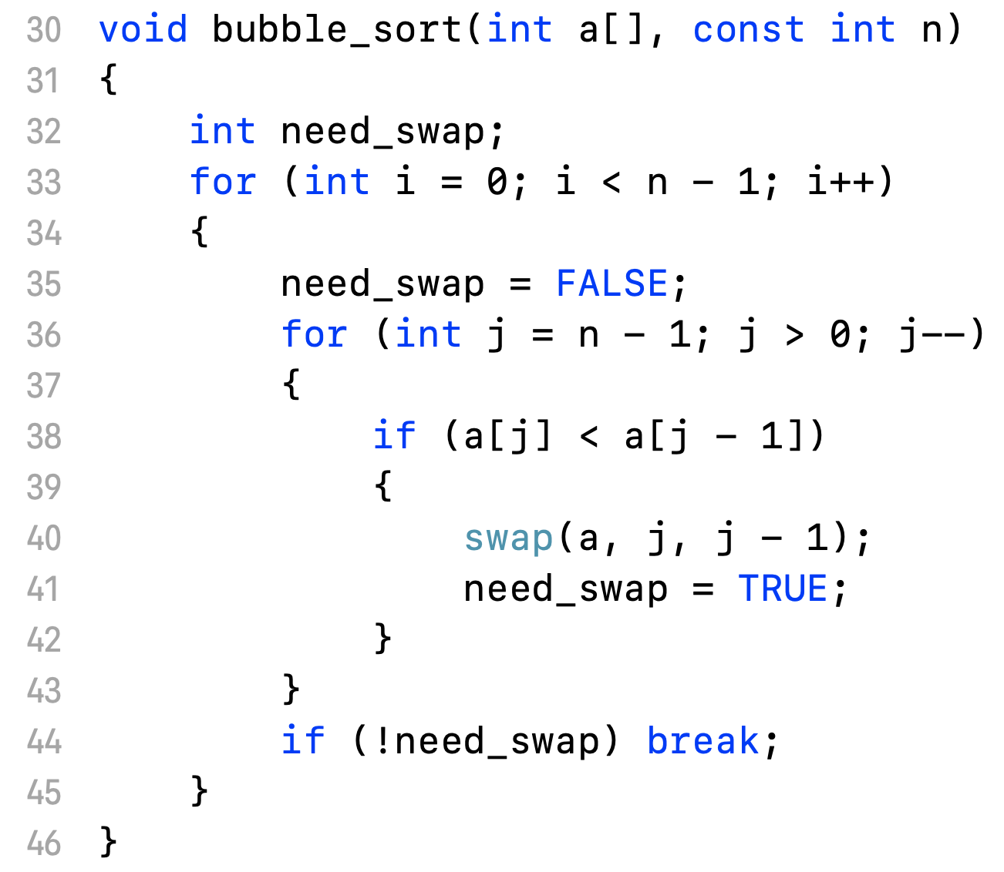
Optimized Bubble Sort
Analysis
Worst case
n(n-1)/2 comparisons
n(n-1)/2 exchanges
Best case
n – 1 comparisons
0 exchanges
=> In best case, O(n)

Slide 8
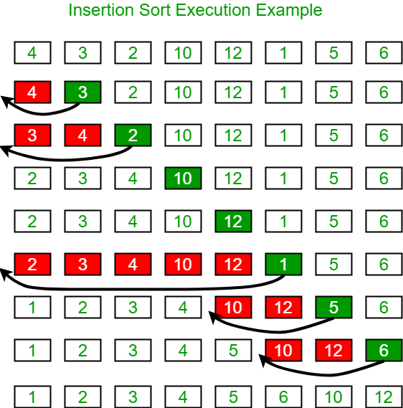
Insertion sort
Key idea: assume the collection is sorted from element 0 to i^{th}. Insert the (i+1)^{th} element to the right place in the sorted part.

Slide 9
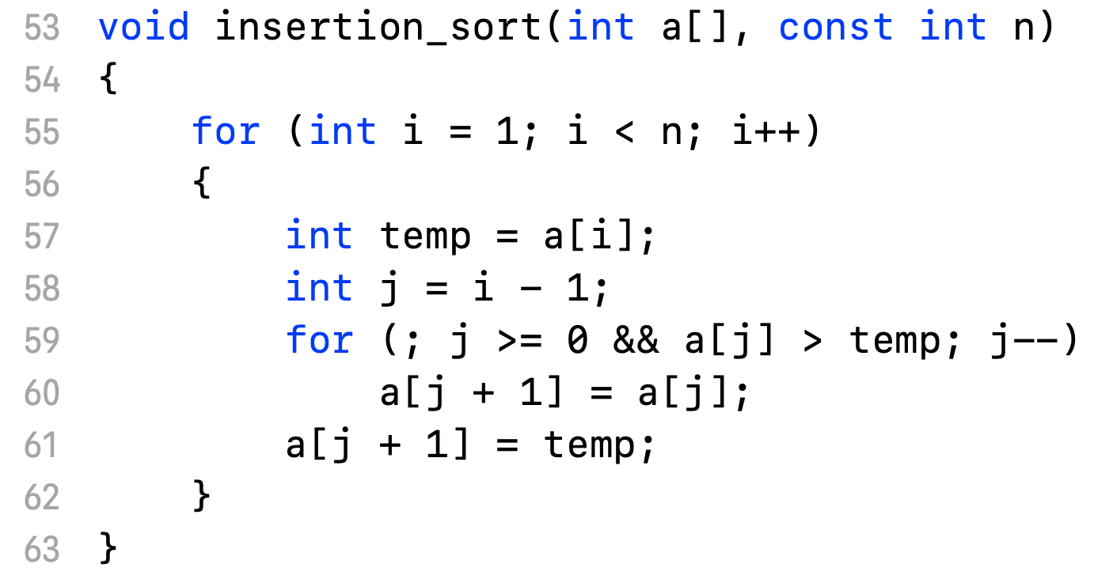
Insertion sort
Insertion sort implementation.

Slide 10
Insertion sort
Analysis
Worst case
n(n-1)/2 comparisons
(n+1)(n-1)/2 exchanges
=> O(n²)
Best case
n-1 comparisons
n exchanges
=> O(n)

Slide 11
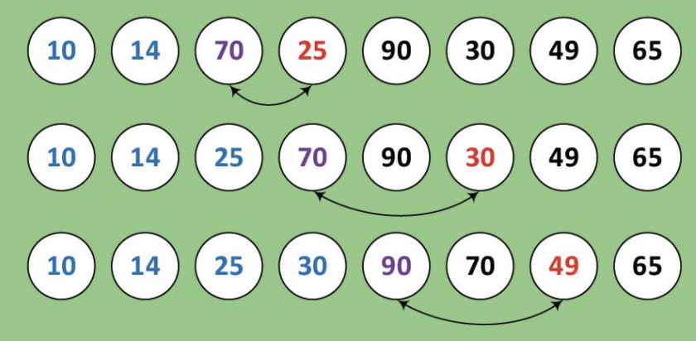
Selection sort
Key idea: Select the smallest element to put in the 1st position, the 2nd smallest element to put in the 2nd position and so on.

Slide 12
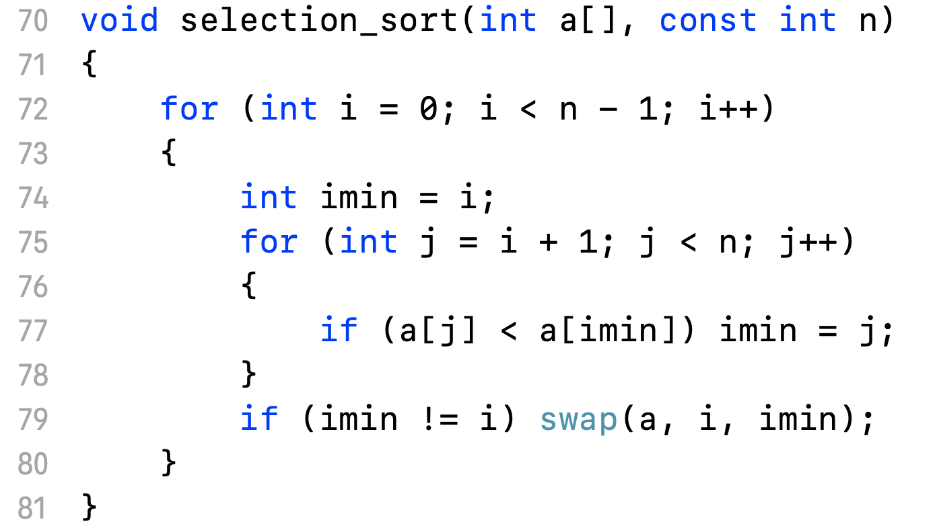
Selection sort
Selection sort implementation

Slide 13
Selection sort
Analysis
Worst case
n(n-1)/2 comparisons
n-1 exchanges
Best case
n(n-1)/2 comparisons
0 exchanges
In general: O(n²)

Slide 14
Comparing Elementary Sort Algorithms
Algorithm | Worst |  | Best |  | Average
 | Comp. | Exch. | Comp. | Exch. | Comp. | Exch.
Bubble | n²/2 | n²/2 | n²/2 | 0 | n²/2 | n²/2
Optimized Bubble | n²/2 | n²/2 | n | 0 | ? | ?
Insertion | n²/2 | n²/2 | n | n | n²/4 | n²/4
Selection | n²/2 | n | n²/2 | 0 | n²/2 | log(n)
[1]. Algorithms in C, Robert Sedgewick

Slide 15
Quick Sort
General ideas, choosing pivot, recursive quicksort, …

Slide 16
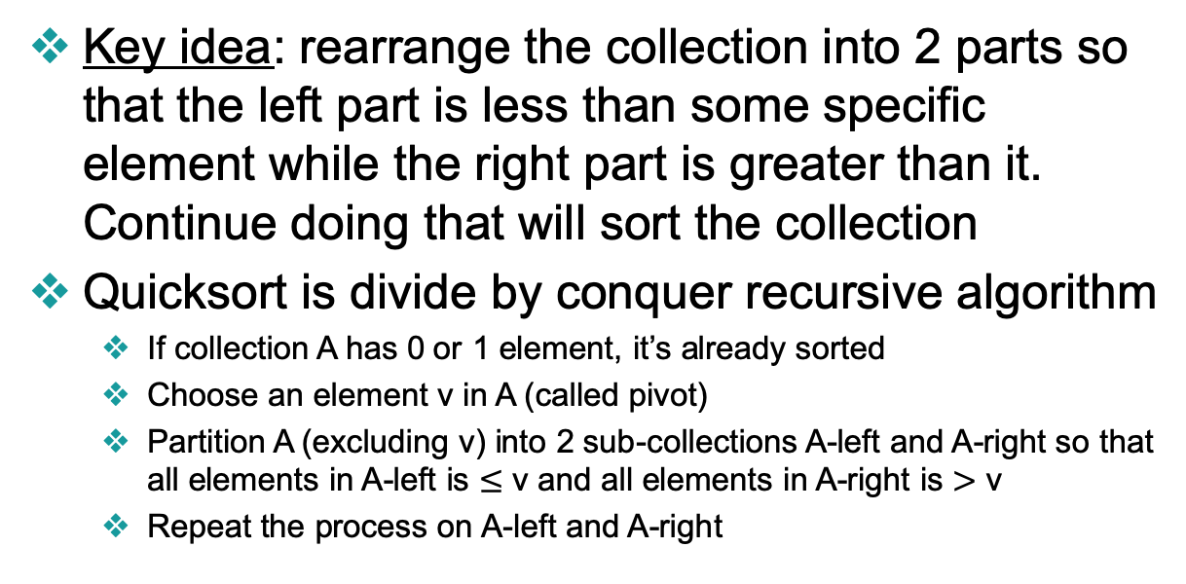
QuickSort
Key idea: rearrange the collection into 2 parts so that the left part is less than some specific element while the right part is greater than it. Continue doing that will sort the collection
Quicksort is divide by conquer recursive algorithm
If collection A has 0 or 1 element, it’s already sorted
Choose an element v in A (called pivot)
Partition A (excluding v) into 2 sub-collections A-left and A-right so that all elements in A-left is $≤$ v and all elements in A-right is $>$ v
Repeat the process on A-left and A-right

Slide 17
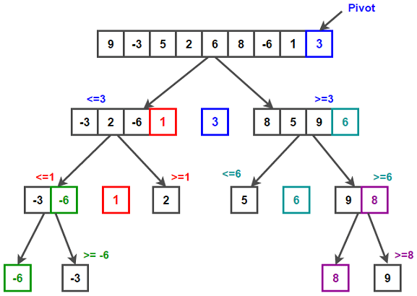
Quicksort Illustration

Slide 18
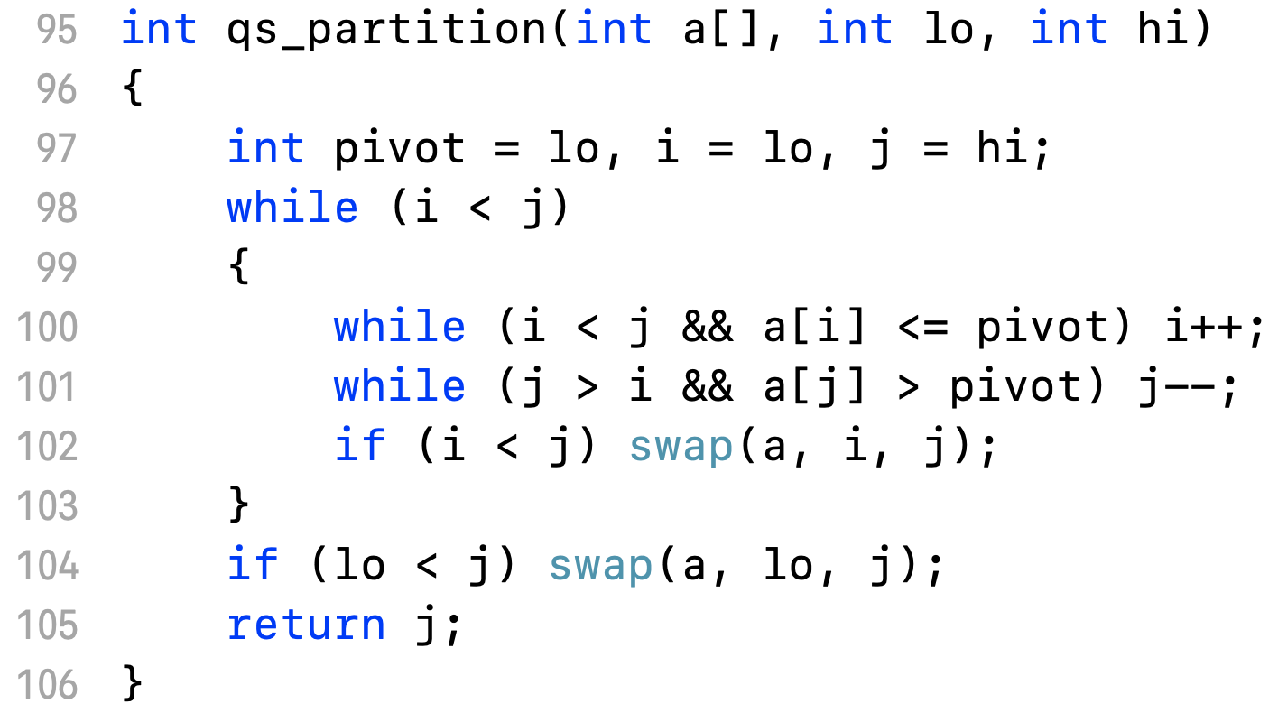
QuickSort Partition
How to choose pivot?
Begin, end, middle or random

Slide 19
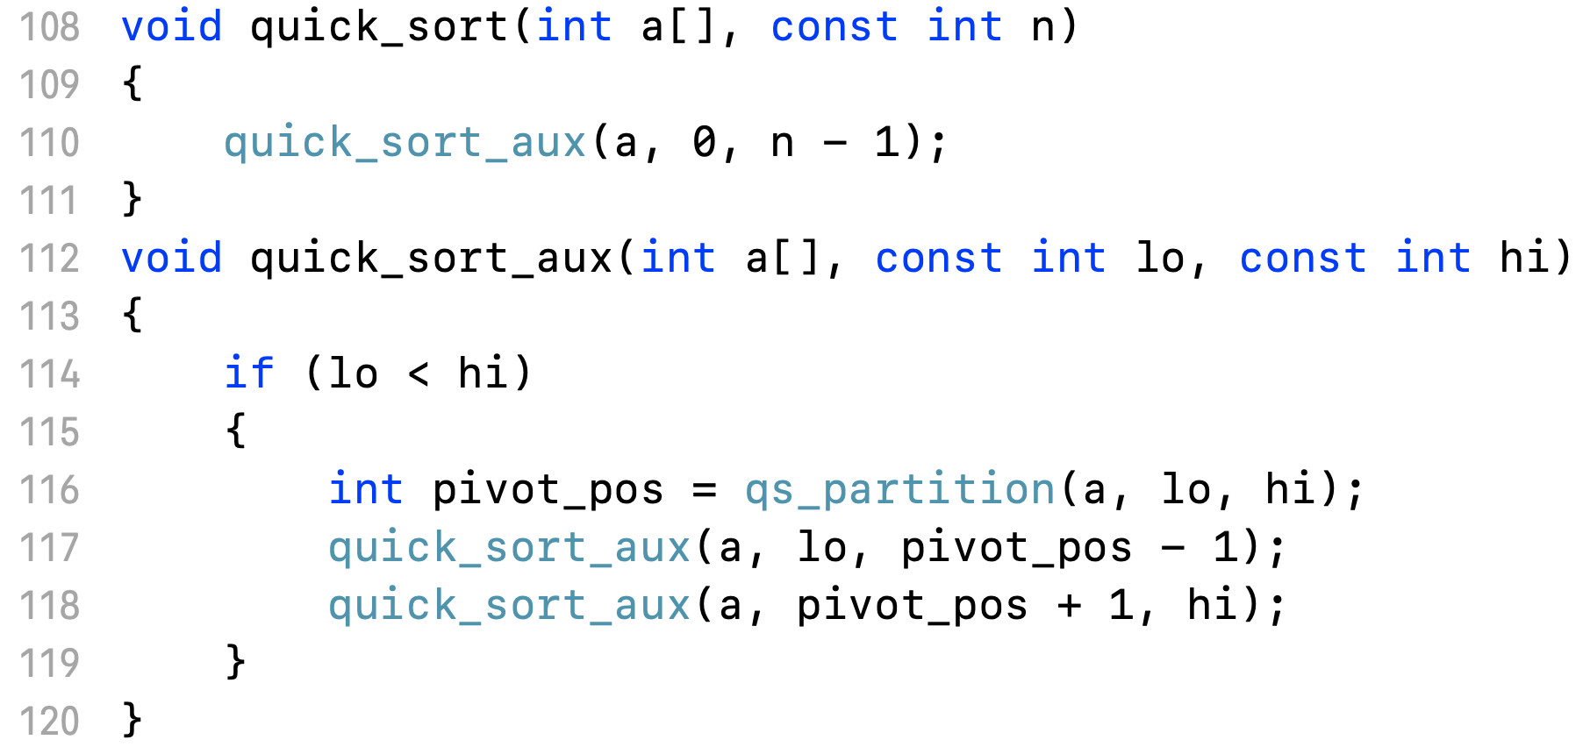
Recursive QuickSort

Slide 20
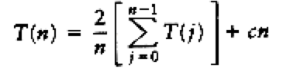
QuickSort Analysis
Best case: pivot is always the middle
T(n) = 2T(n/2) + cn => O(nlogn)
Worst case: pivot is always the smallest
T(n) = T(n-1) + cn => O(n²)
Average case: pivot is randomly distributed
=> O(nlogn)
[2]. Data structures and algorithms in C, Mark Allen Weiss

Slide 21
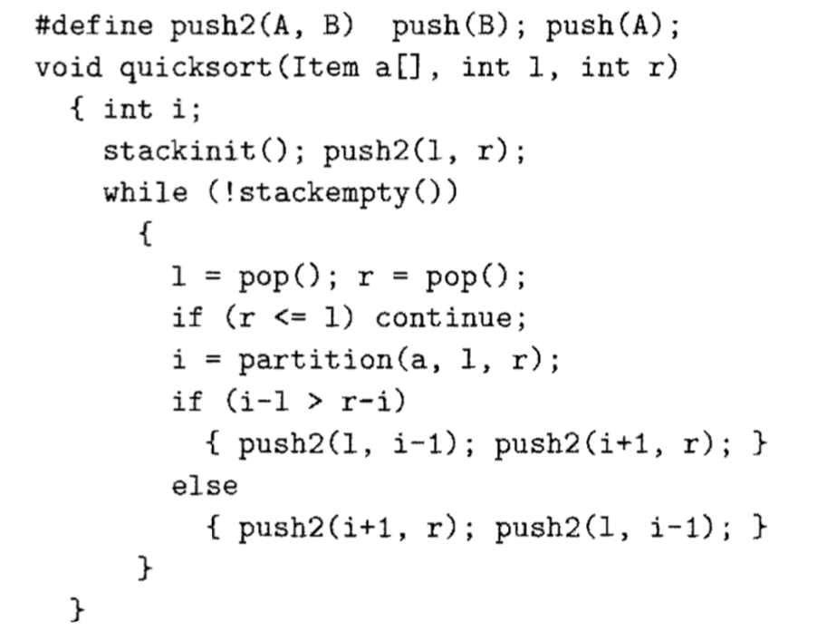
Non-recursive QuickSort
[1]. Algorithms in C, Robert Sedgewick

Slide 22
Recursive vs Non-recursive QuickSort
Normally recursive is slower than iterative because of the overhead of recursive stack
But QuickSort is tail-recursive so it doesn’t really matter
Some modified version of QuickSort use a threshold and if number of elements is less than it then an elementary sort will be used

Slide 23
Merge Sort
General ideas, merging, recursive mergesort, …

Slide 24
Merge Sort
Key ideas: if we have 2 sorted collections, we can merge them to have 1 sorted collection.

Slide 25
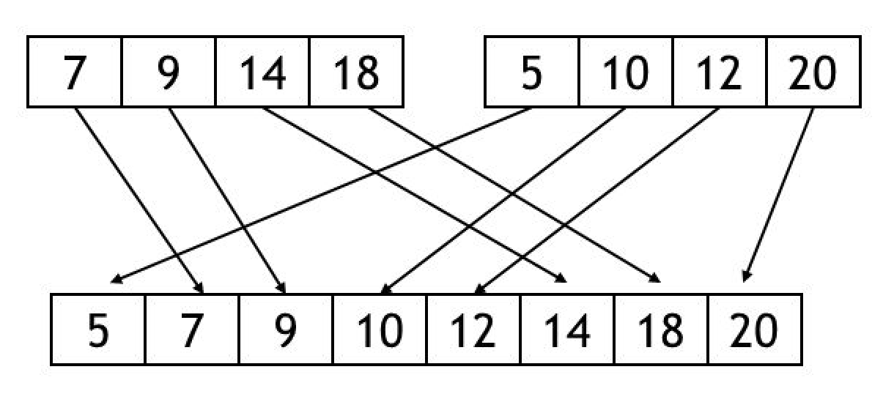
Merge Sort
Merge process: Repeatedly compare the 2 least elements and copy the smaller one to the 2nd collection.

Slide 26
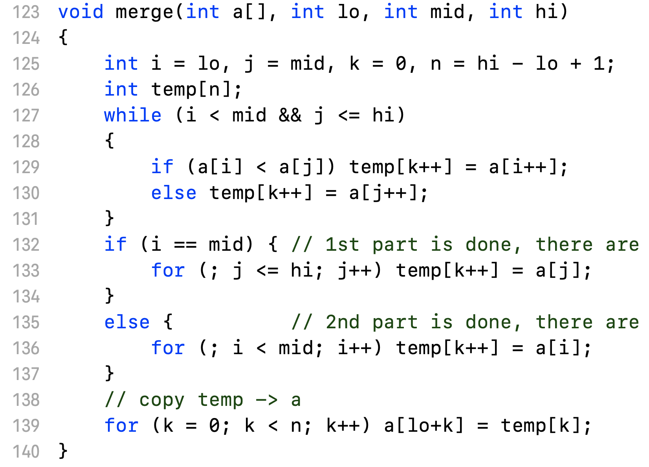
Merge Sort
Implementation of merge process

Slide 27
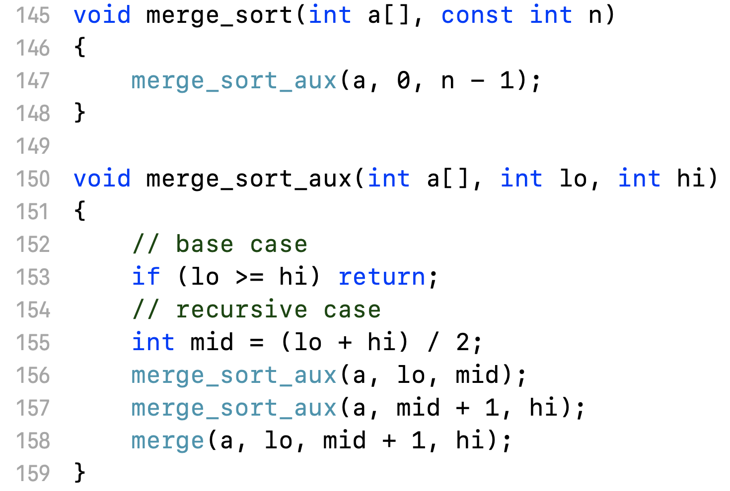
Recursive MergeSort

Slide 28
Merge Sort Analysis
The key is to merge 2 sorted collection so no best case
T(n) = 2 T(n/2) + cn
=> O(nlogn)
Although mergesort's running time is O(n log n), it is hardly ever used for main memory sorts. The main problem is that merging two sorted lists requires linear extra memory, and the additional work spent copying to the temporary array and back, throughout the algorithm, has the effect of slowing down the sort considerably.

Slide 29
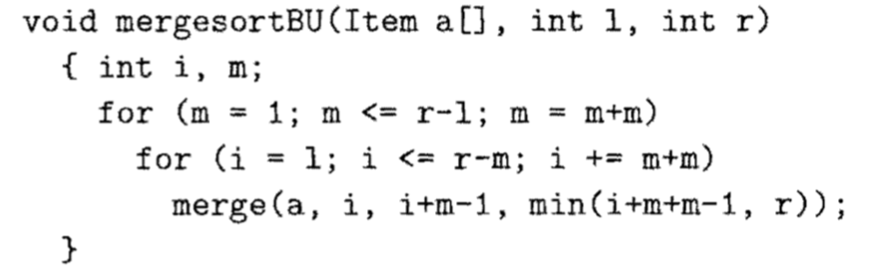
Other MergeSort Algorithms
Non-recursive or bottom-up MergeSort
Still O(nlogn), still need to use extra space to copy

Slide 30
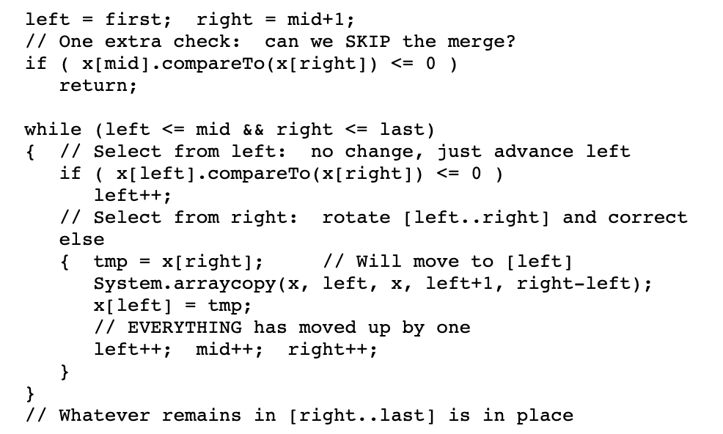
Other MergeSort Algorithms
In-place MergeSort
No need for extra space but O(n²)

